Slide 1
Introduction of CCS and IRN system
Friday, June 7, 2024

Slide 2
What is Autotoll?
Autotoll is a solution provider for IT industry.
Autotoll was established on 1 October 1998.
Office
Billion Centre (Kowloon Bay), 2.5 floors, over 200 staff.
Evergain Centre (Kwai Chung), over 20 staff.
GZ E-Park, office 100 staff .

Slide 3
What Autotoll is doing?
Current project
Private sector
CLP SOSS (Safely On-Site System), Entrance Control, Shutter Bus, Car booking
Truck management (GPS), > 20 thousand vehicle monitored.
RehaBus
EV charging
Jackson Coach
OLTD for Skip
Government sector
eToll
TD57/93 (stage 1, 2)
Smart Lamp Post
Land’s department, SPIMS (Smart Position Instrument Management System)
Traffic Control System (Tunnel, highway), TMCA, CKR, TSCA…
SCC (Smart City Consortium) Recycle Collection Project

Slide 4
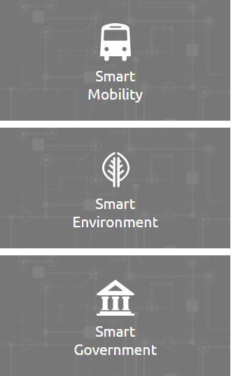
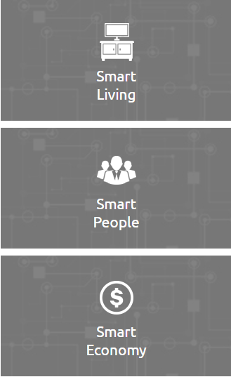
Background
Hong Kong Smart City Blueprint (https://www.smartcity.gov.hk/)
Six Major Areas:
Six Major Areas:
December 2017
Smart mobility 智慧出行
(d) Intelligent Transport System and Traffic Management
智能運輸系統及交通管理
Smart people 智慧市民
Smart living 智慧生活
Smart government 智慧政府
Smart environment 智慧環境
Smart economic 智慧經濟

Slide 5
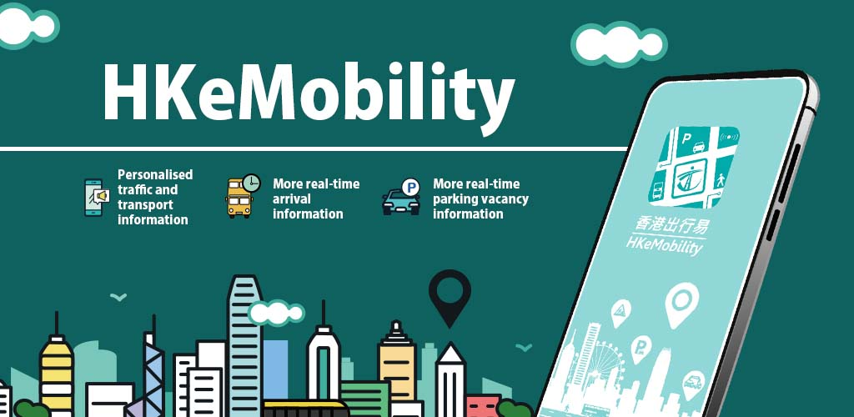
Background
One of the smart mobility initiatives is to install about 1200 traffic detectors on all strategic routes to provide real-time traffic information to the public via “HKeMobility” mobile app
The major project objective is to estimate average speeds on the strategic routes based on the segments of Intelligent Road Network (IRN) at 2-minute time interval.

Slide 6
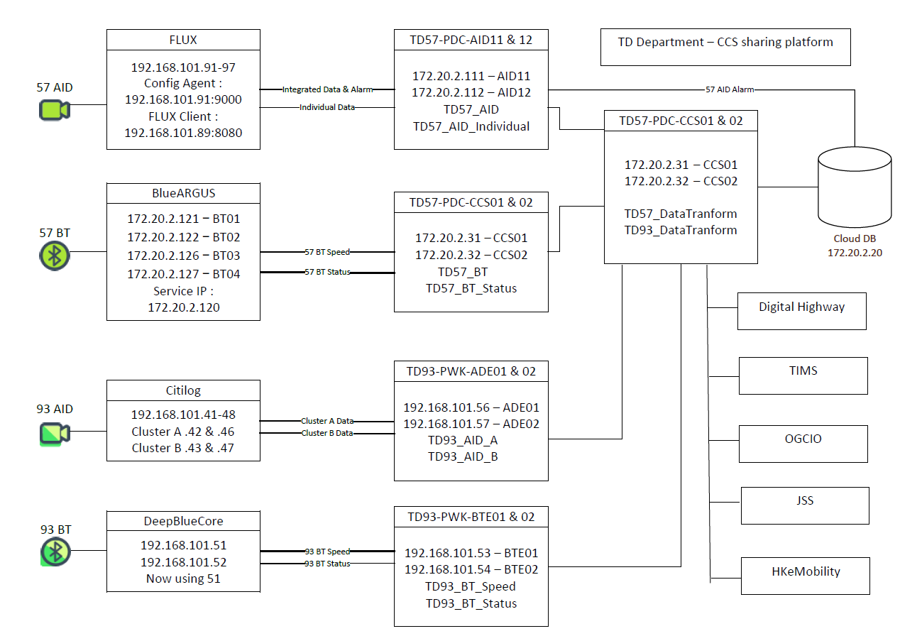
TD57/93 Data Flow Diagram

Slide 7
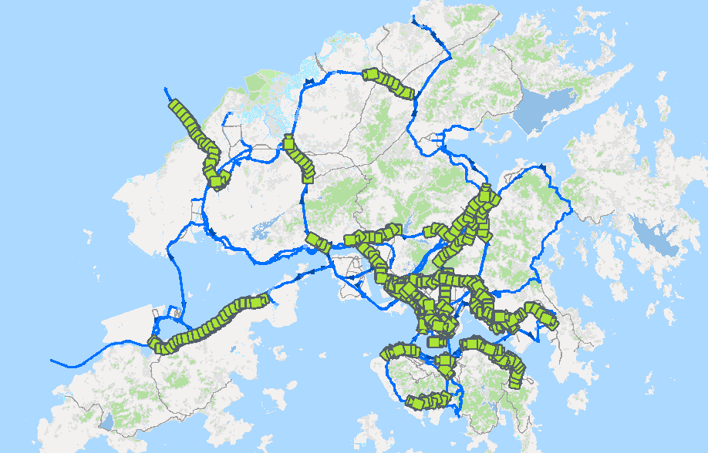
TD57 – Total 454 AIDs

Slide 8
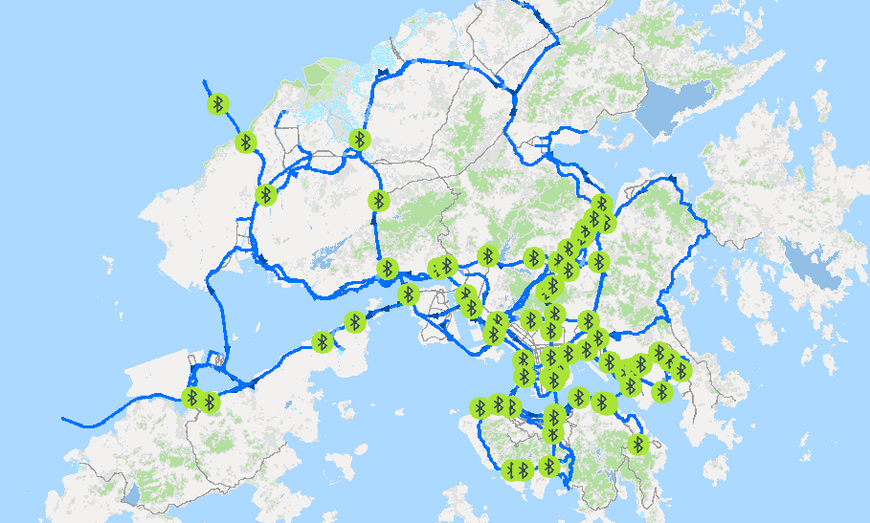
TD57 – Total 70 BTs (171 BT pairs)

Slide 9
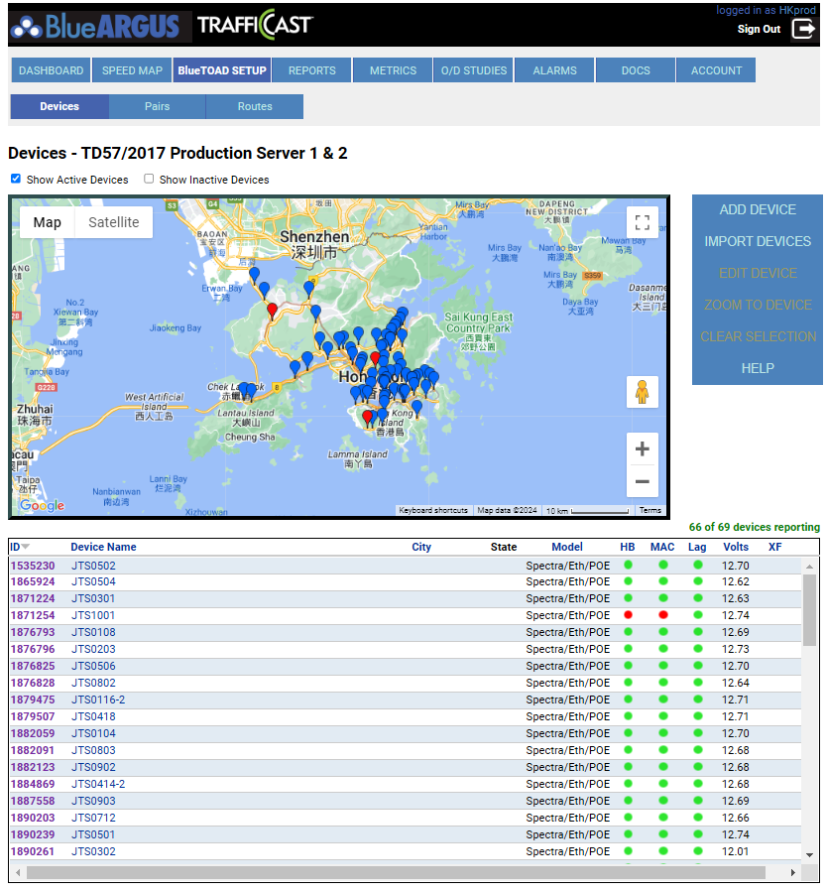
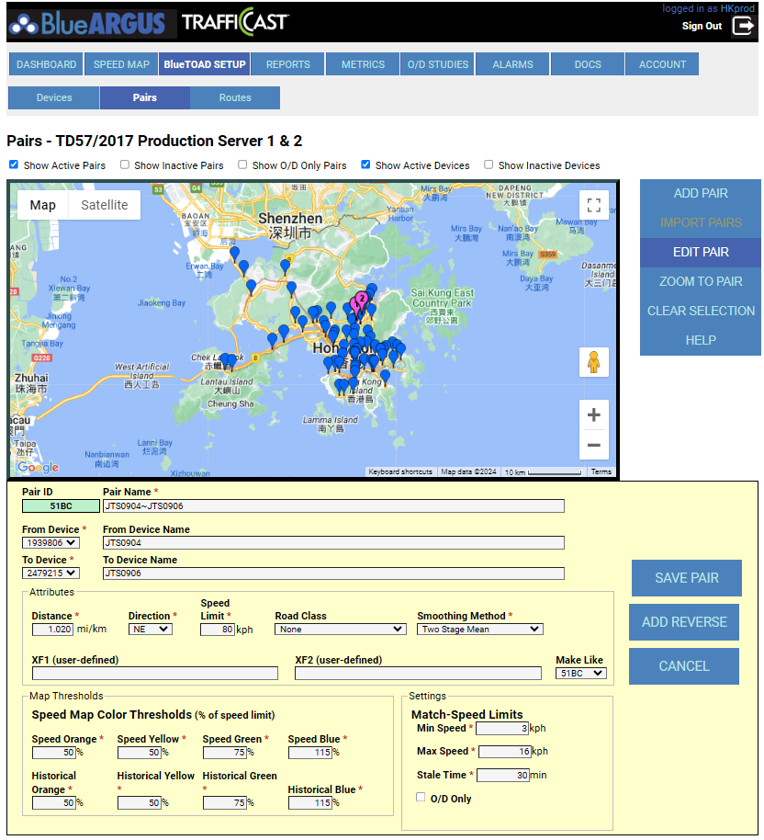
TD57 – BlueARGUS (For BT only)

Slide 10
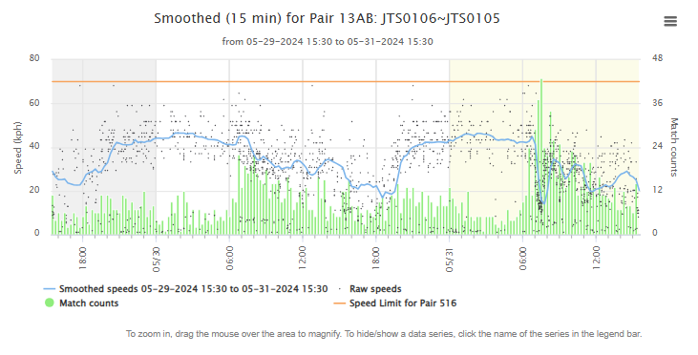
TD57 – BlueARGUS (For BT only)

Slide 11
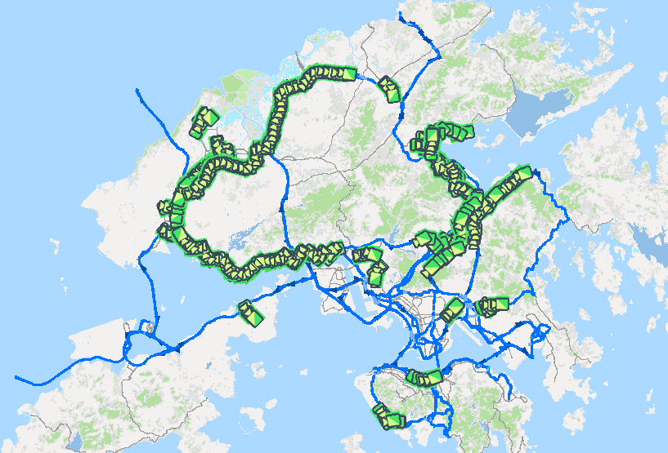
TD93 – Total 367 AIDs

Slide 12
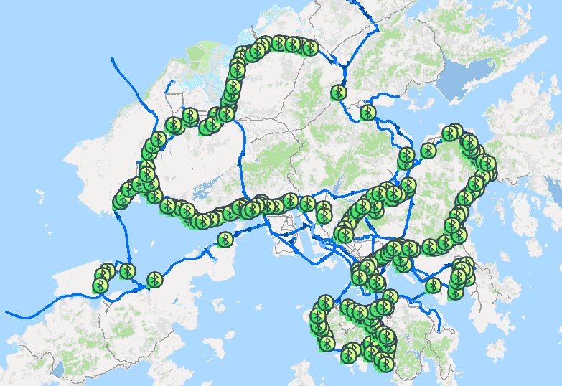
TD93 – Total 263 BTs (638 BT pairs)

Slide 13
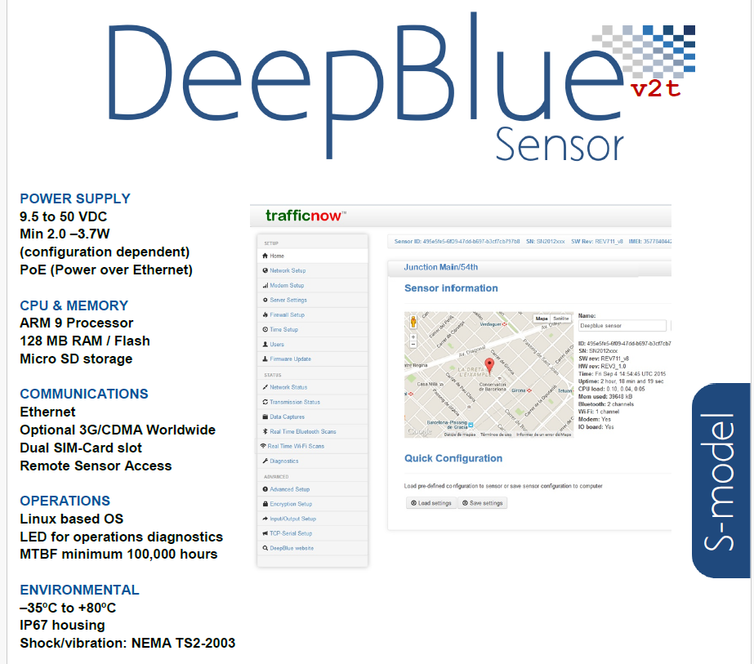
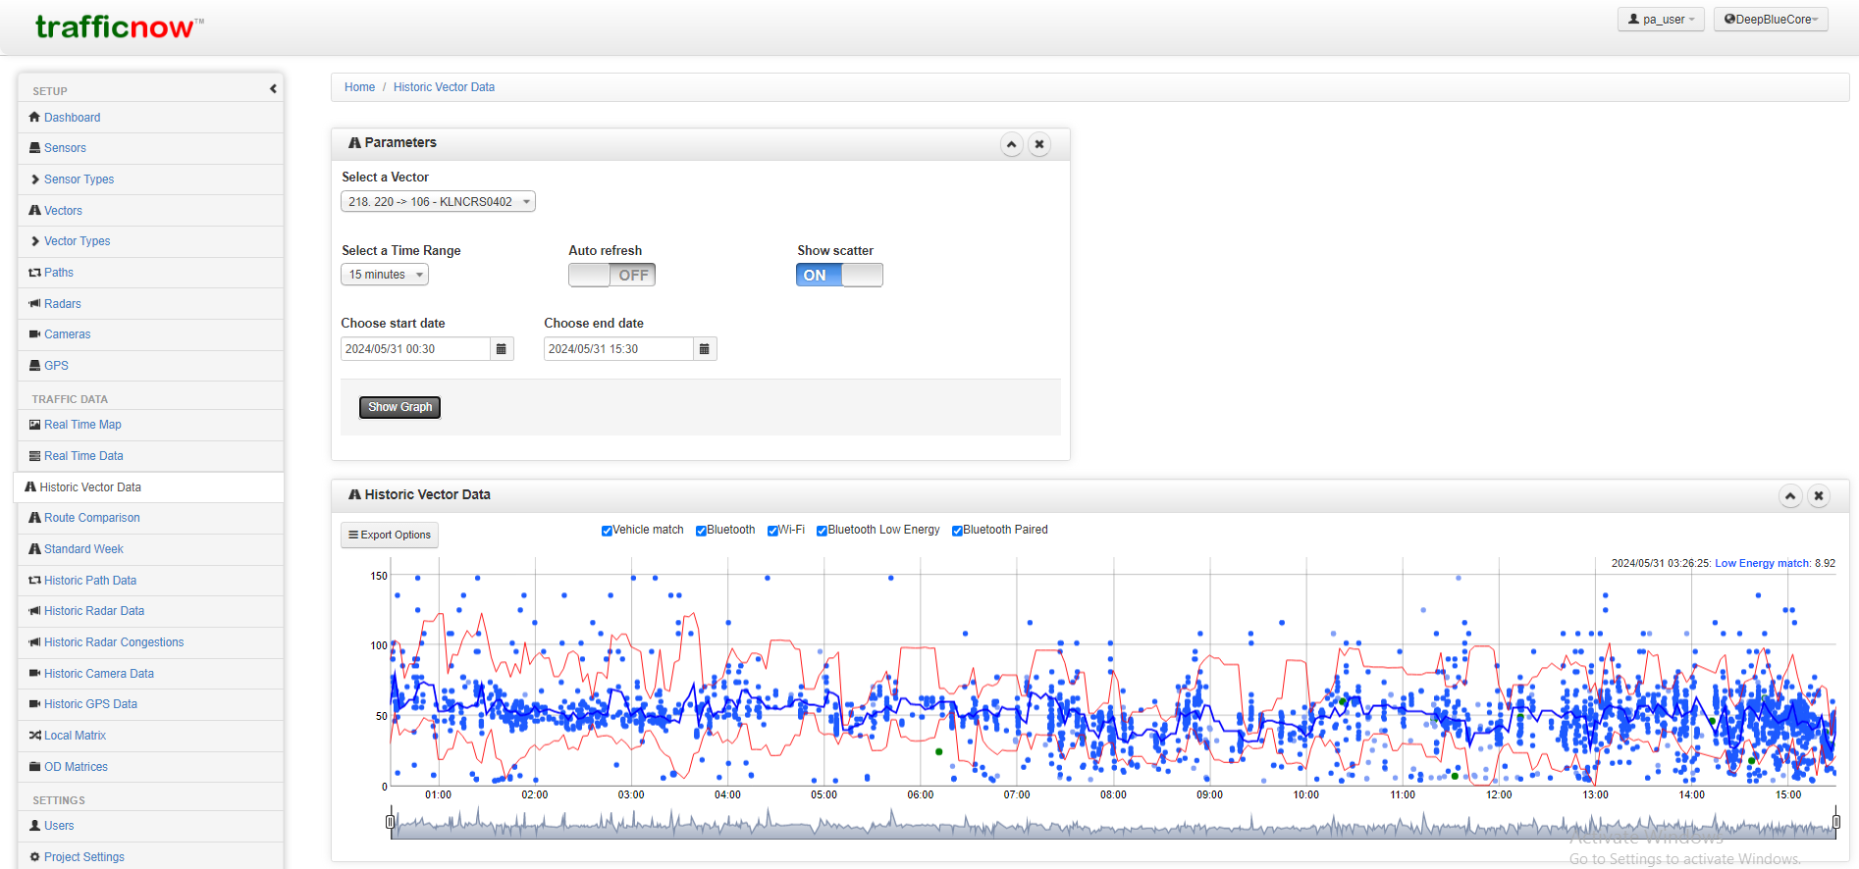
TD93 – Trafficnow (DeepBlue) (For BT only)

Slide 14
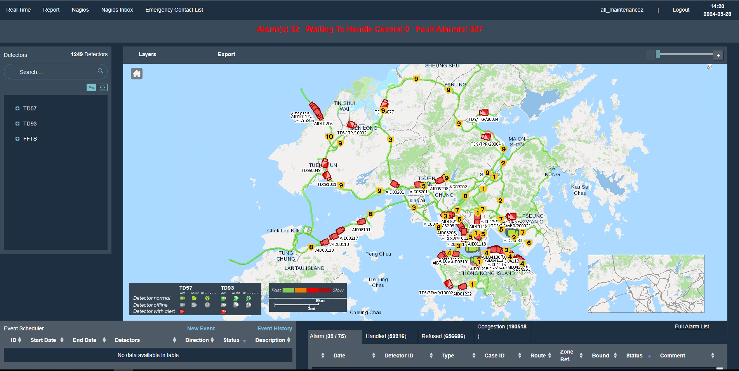
Major functions of CCS:

Slide 15
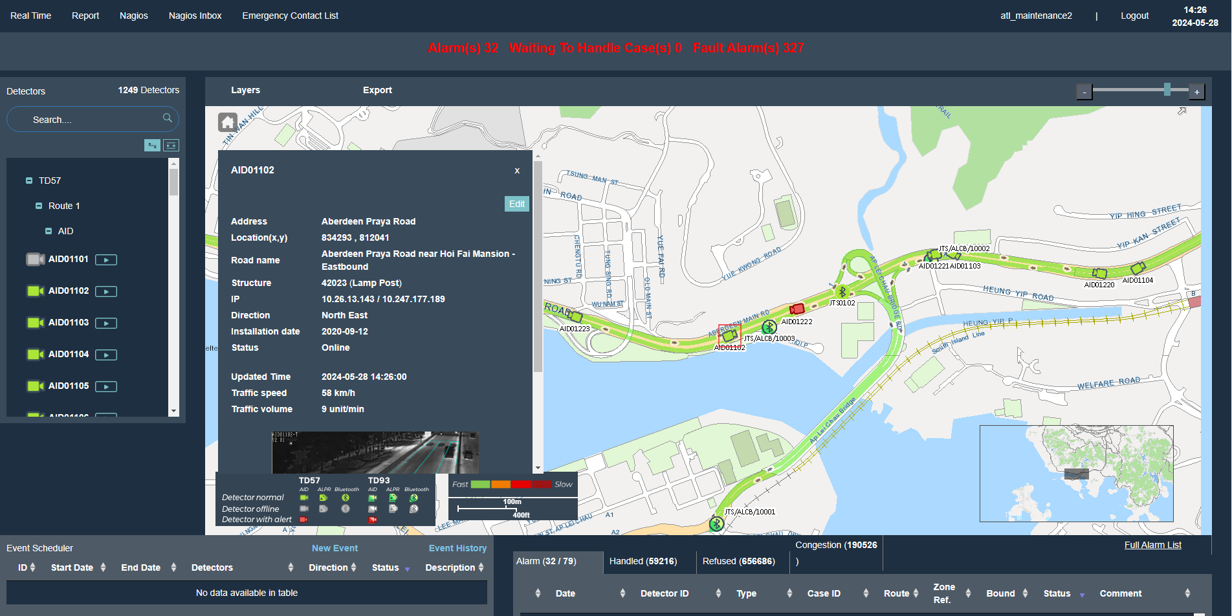
1. Locate AID/ BT/ Toll Point

Slide 16
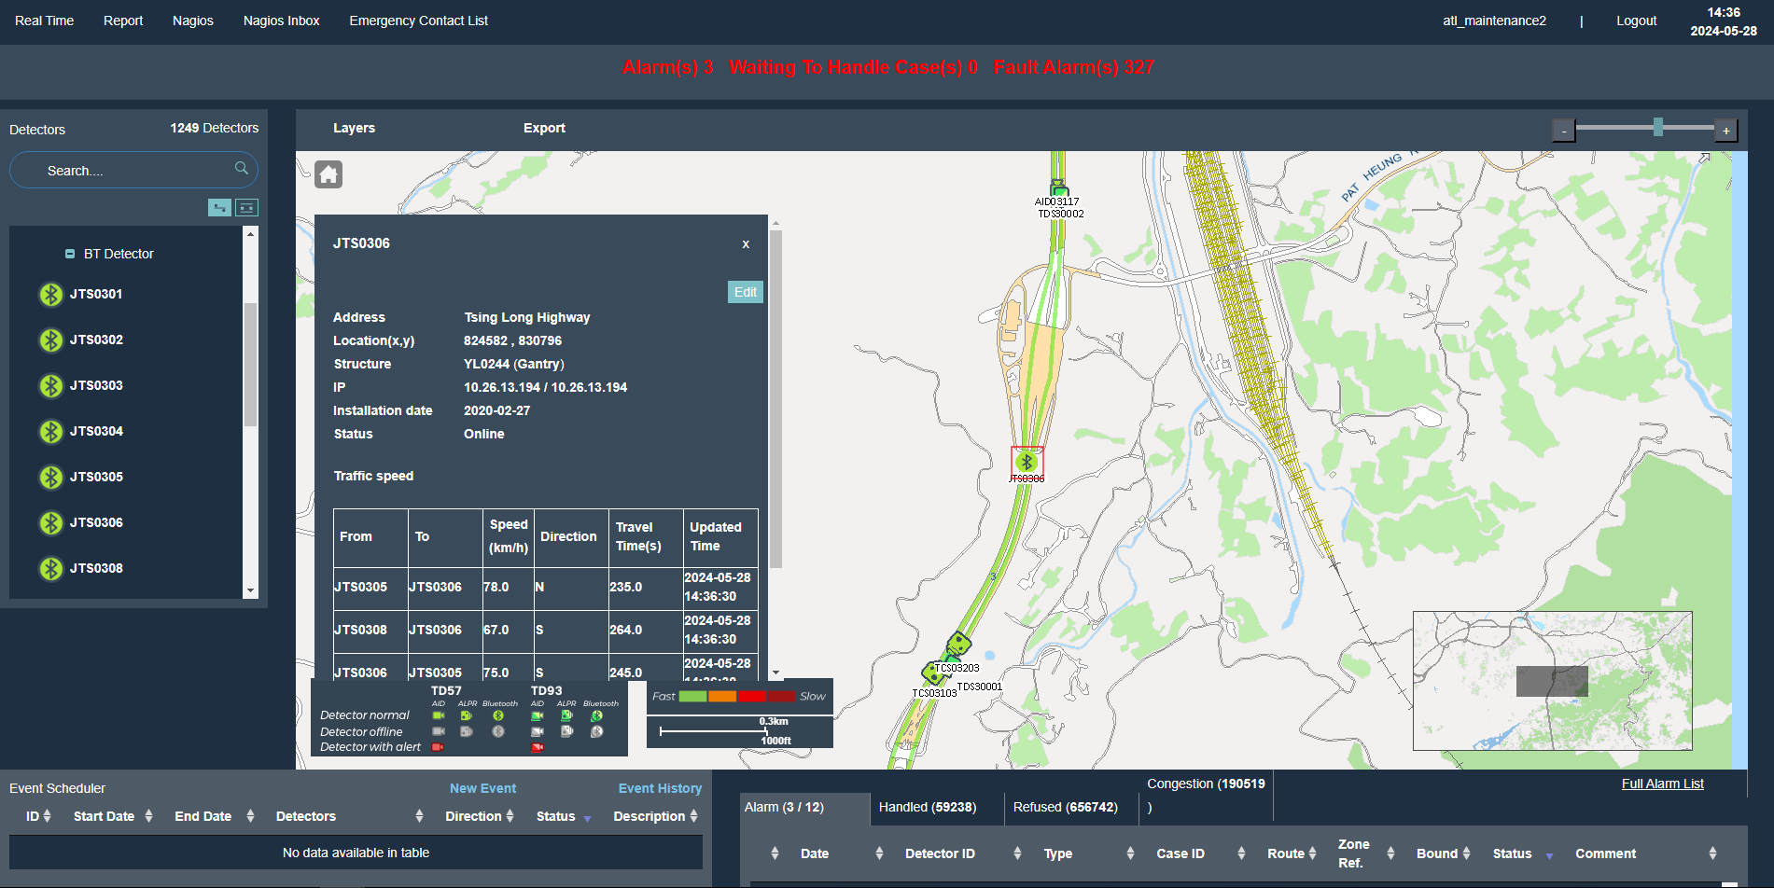
2. Real time AID/BT data

Slide 17
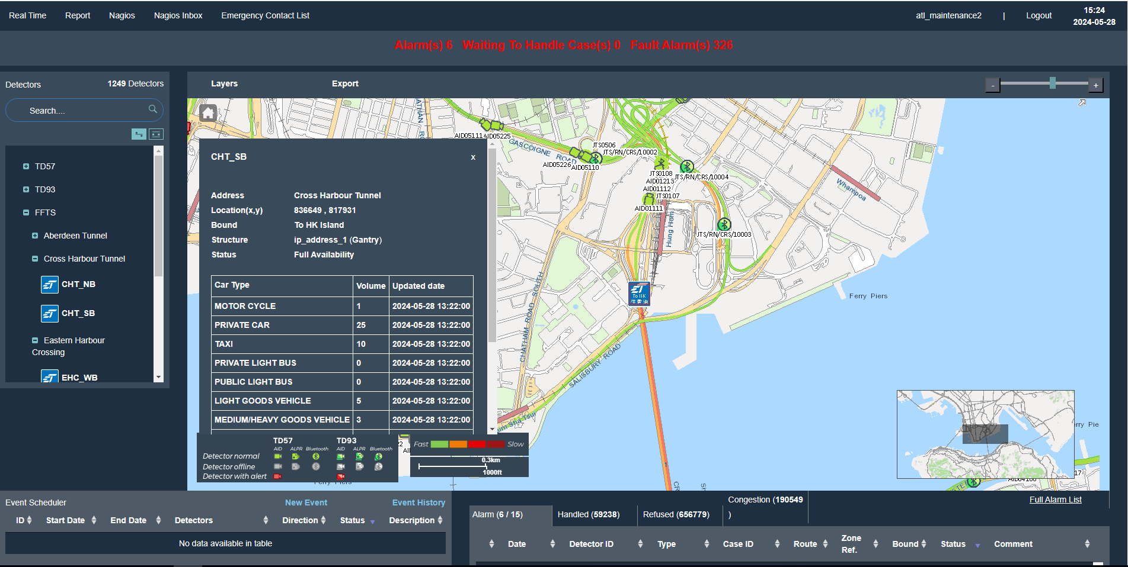
Toll point data

Slide 18
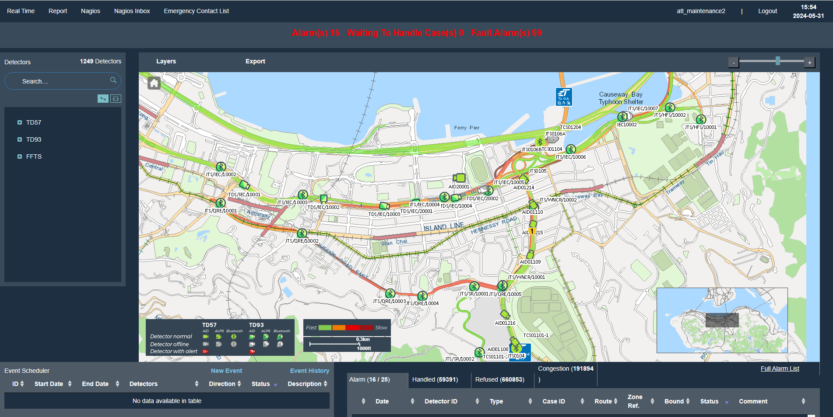
3. Real time traffic speed (HKeMobility)

Slide 19
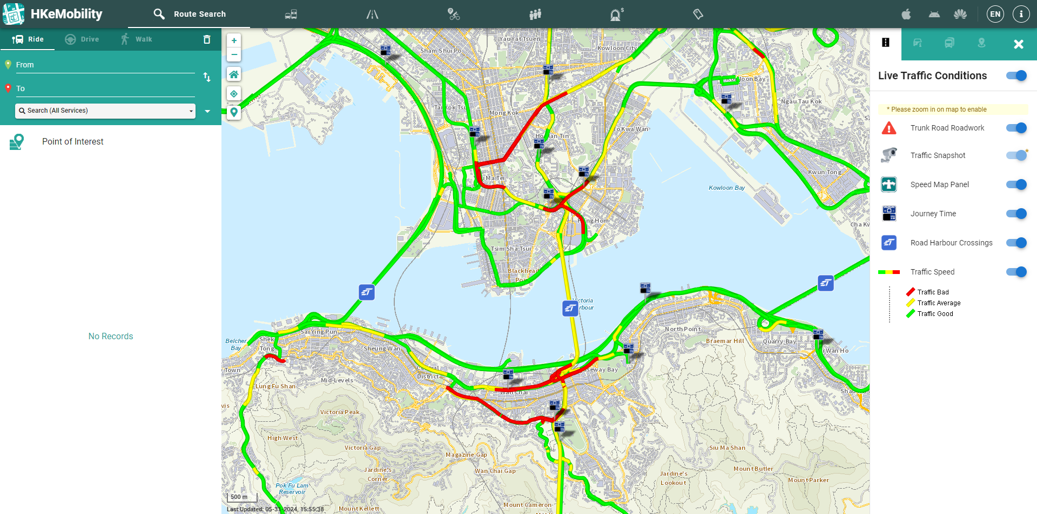
HKeMobility – Share same data source with CCS

Slide 20
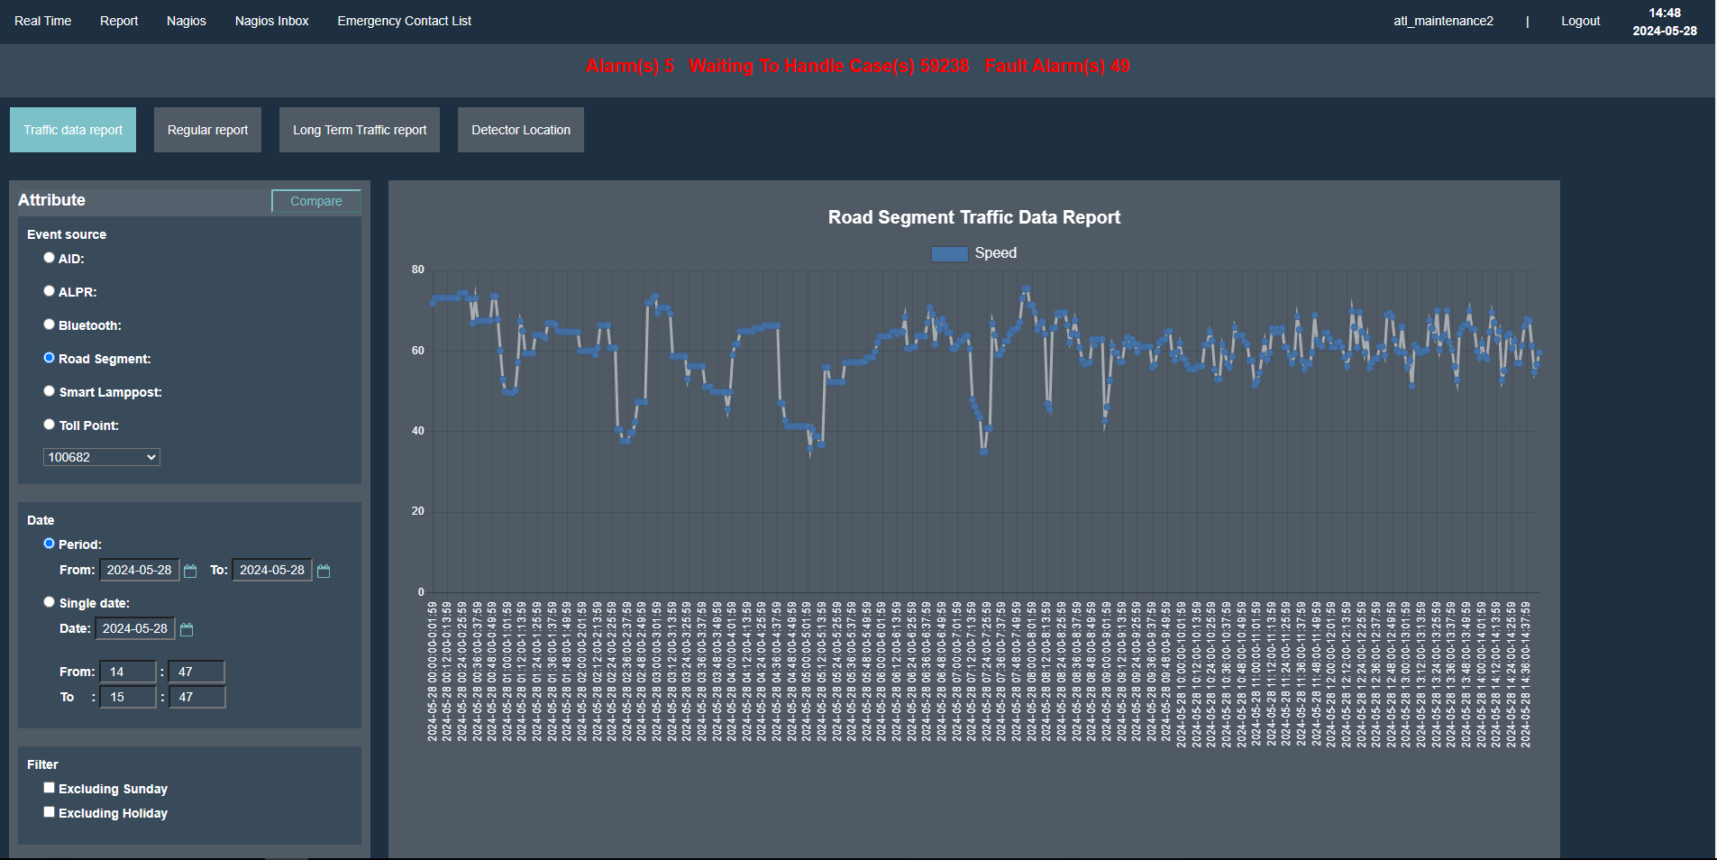
4. Report

Slide 21
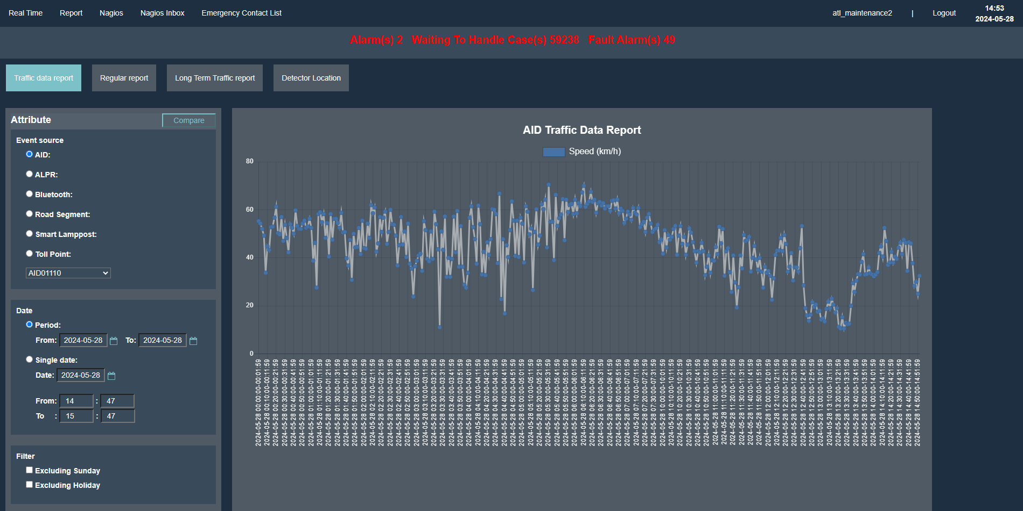
Checking the latest or past data (speed) of IRN/BT/AID AID:

Slide 22
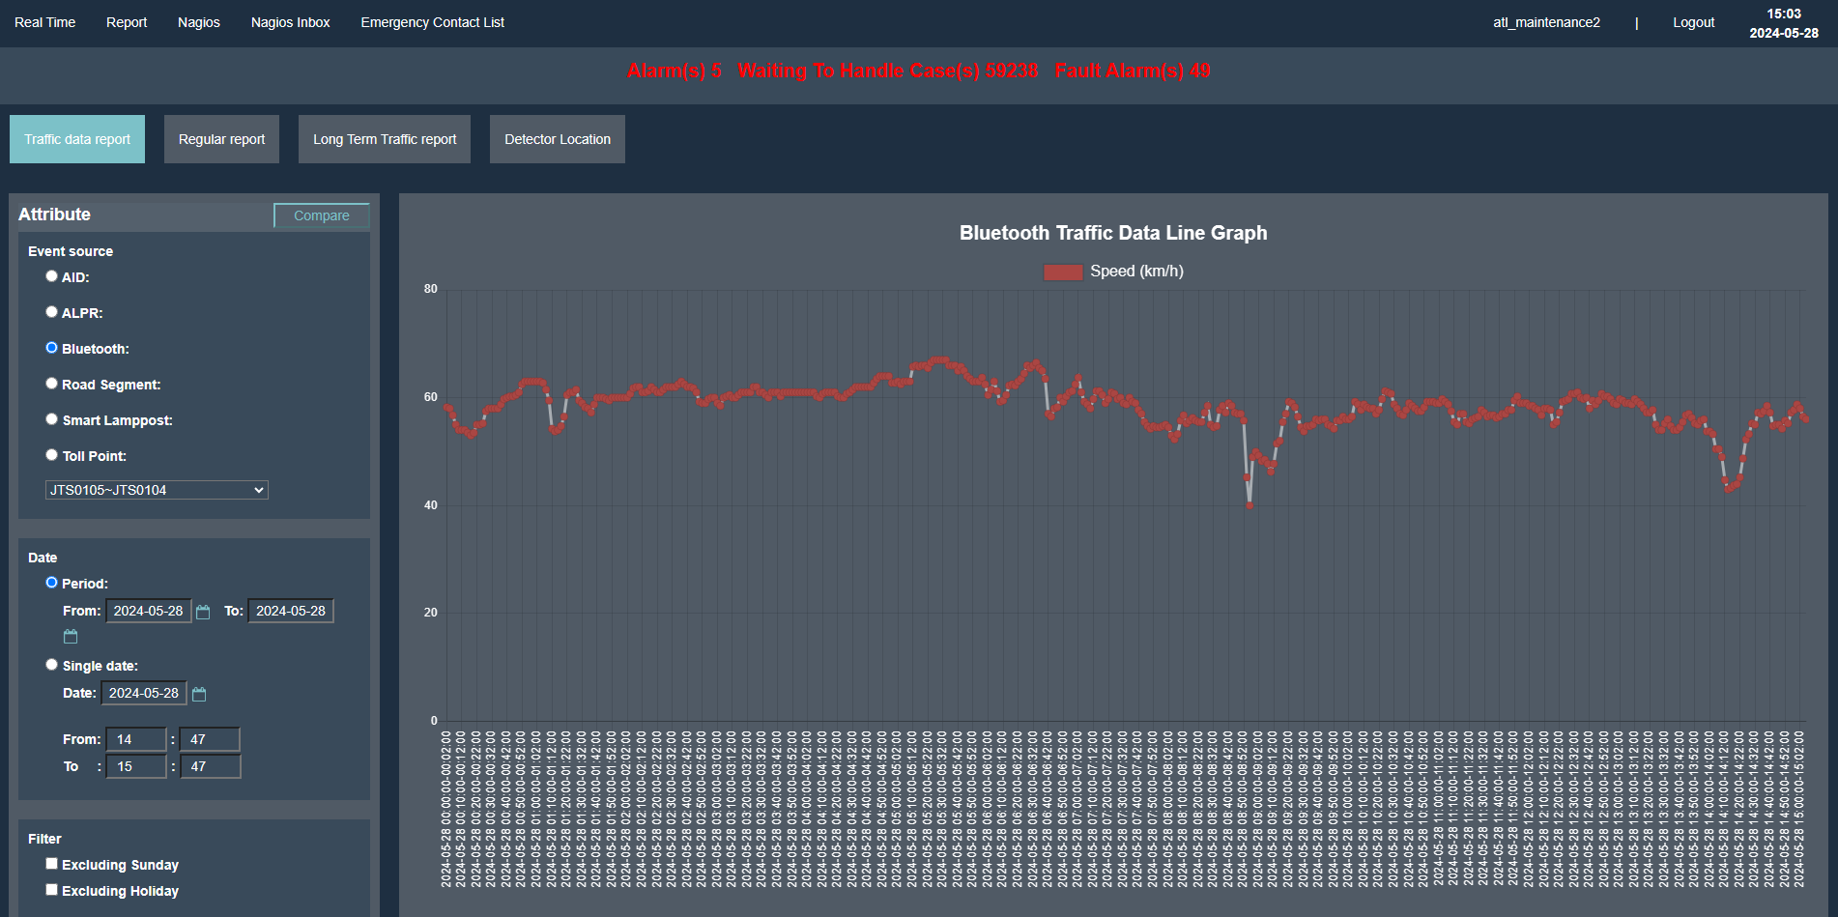
Bluetooth:

Slide 23
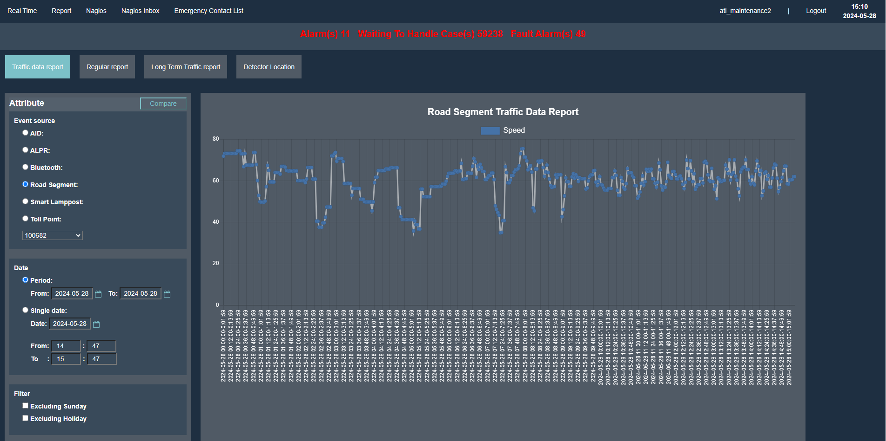
Road Segment (IRN)

Slide 24
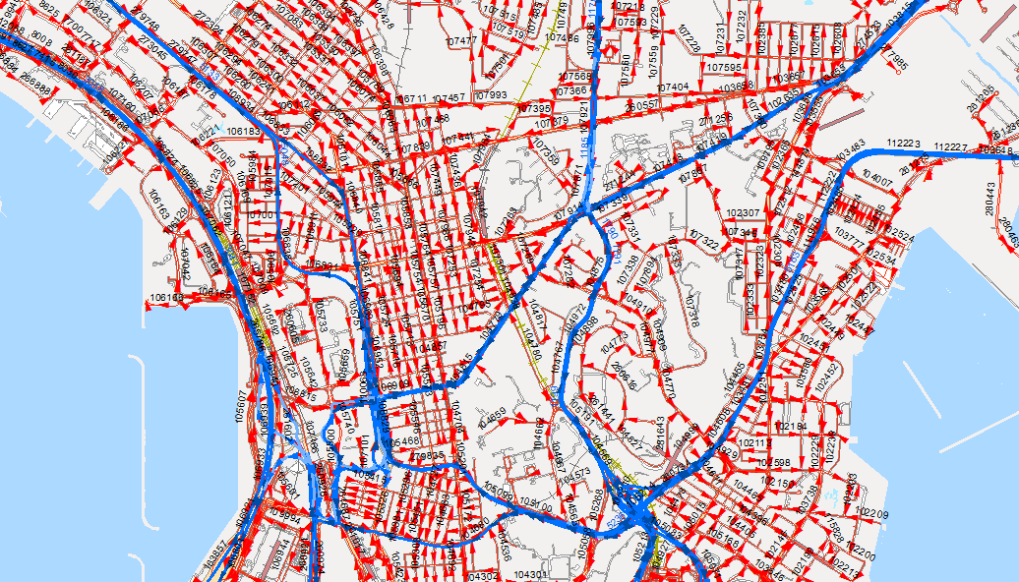
IRN (Intelligent Road Network)
Currently total 5693 IRNs on use (update continuously)
ꟷꟷꟷ Centerline
ꟷꟷꟷ IRN

Slide 25
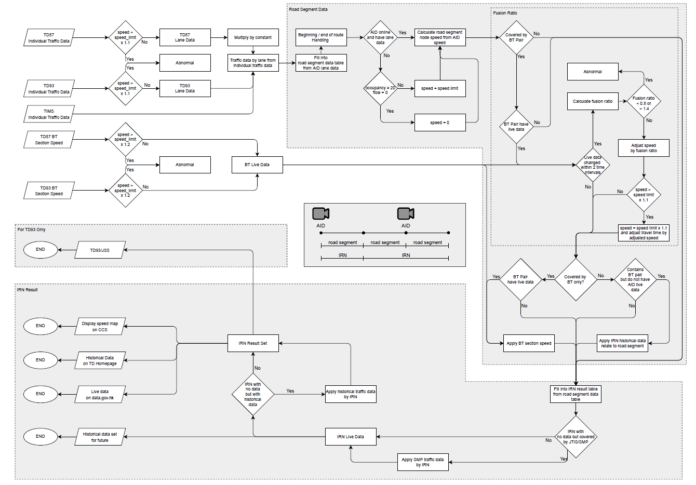
IRN calculation workflow

Slide 26
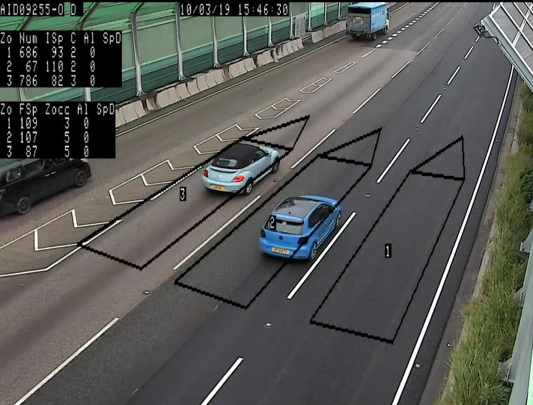
IRN with AID Data
AID detectors:
Spot speed of individual vehicle & vehicle counts

Slide 27
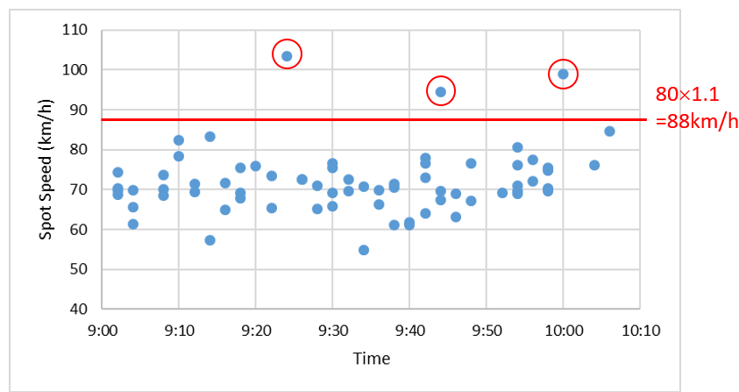
AID Data cleansing
Clean the spot speeds of individual vehicles collected by AID detector
- To eliminate unreasonable speeding data
The validated spot speed data of individual vehicles collected in every 2 minutes will then be used to calculate the average spot speed (i.e. time mean speed) in that 2-min time interval.
Example:
Speed limit = 80 km/h
Speed > (1+ β %) of speed limit (say, β =10) will be screened out

Slide 28
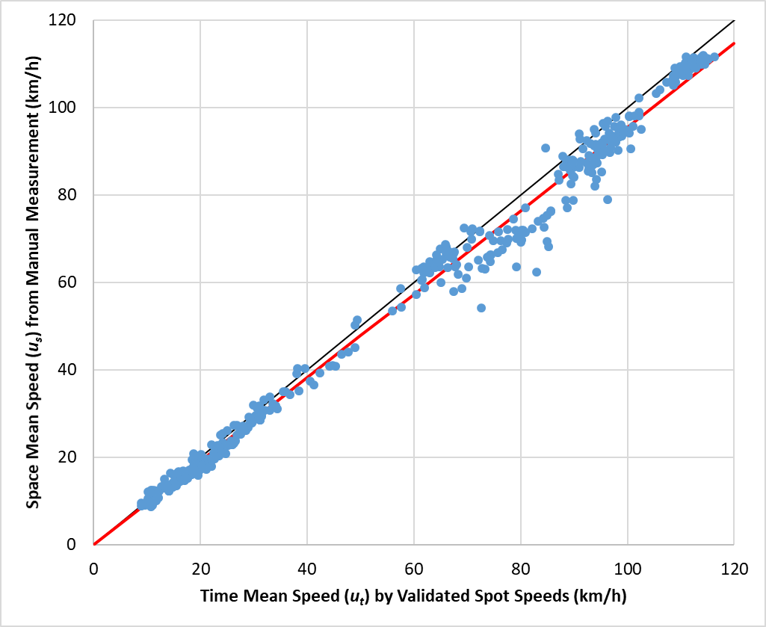
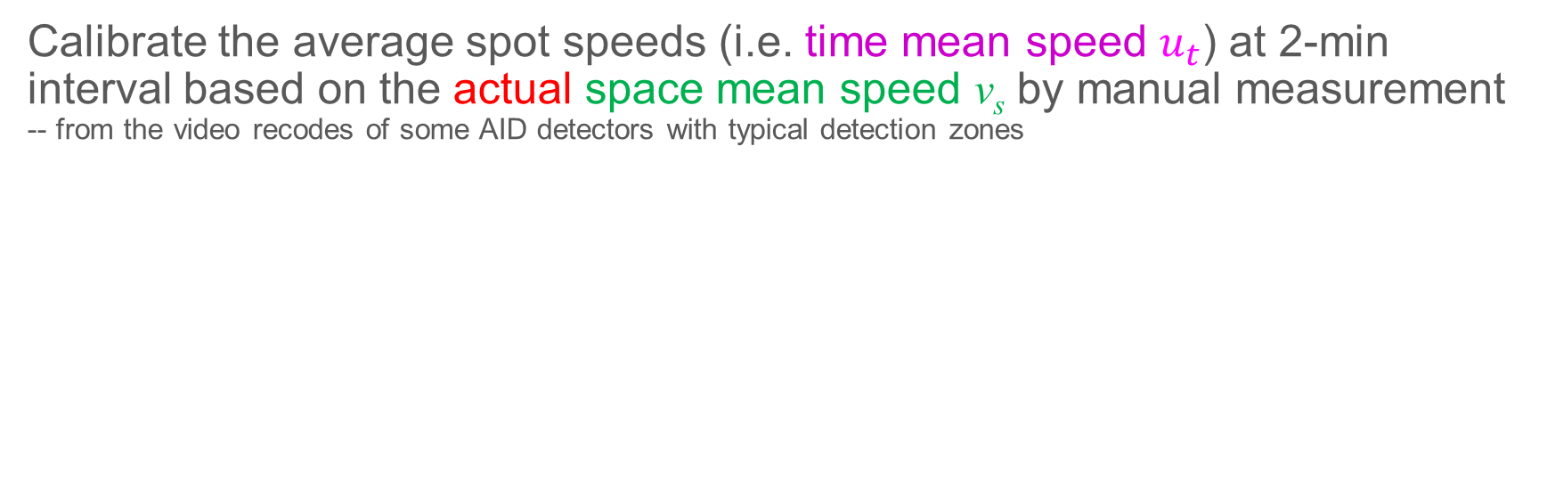
AID Data calibration (Time mean speed → space mean speed)
Calibrate the average spot speeds (i.e. time mean speed $u_{t}$) at 2-min interval based on the actual space mean speed v_{s} by manual measurement -- from the video recodes of some AID detectors with typical detection zones
Standardized length of detection zones (say, 12m) is required to facilitate the calibration work for different sites
v_{s} = 0.9554u_{t}
R² = 0.991
Spot speed
Space speed
12 m
12 m
IRN segment
12 m
Differences between time mean speed (u_{t}) and actual space mean speed (v_{s}) from manual measurement
Calibration is based on the time mean speeds on the corresponding traffic lanes of the associated IRN segments

Slide 29
Data Fusion For Estimating Average Speeds on IRN Segments per Bound
Noted that AID detectors capture the spot speeds by traffic lane by direction. Thus, the space mean speeds will be calibrated based on the time mean speeds on the corresponding traffic lanes of the associated IRN segments.

Slide 30
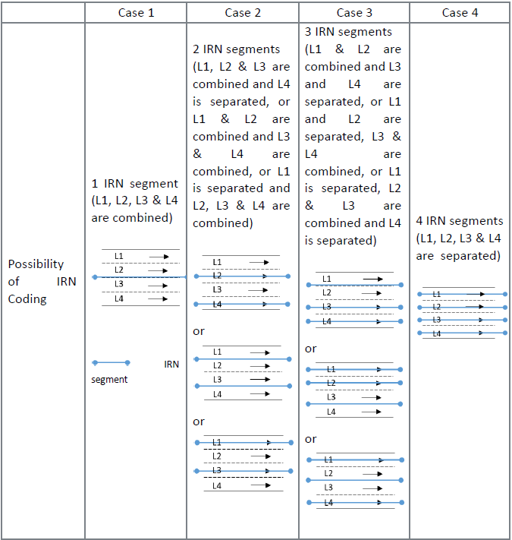
Data Fusion For Estimating Average Speeds on IRN Segments per Bound

Slide 31
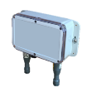

IRN with Bluetooth Data
Bluetooth (BT) detectors: Travel time between two BT detectors
A
B
MAC address: 00:11:22:33:FF:EE
10:32:00am
MAC address: 00:11:22:33:FF:EE
10:38:00am
Distance = 1.7 km
Measured travel time = 6 min
Average speed = 17 km/h
Travel time between A and B = 6 min
Note that the measured travel time would be the actual travel time for the completed journey between two BT detectors.

Slide 32
Data Fusion for Estimating Average Speeds on IRN at 2-min Interval
AID detector 2
Time mean speeds at 2-min interval (after data cleansing of AID spot speed data)
AID detector 1
Space mean speed v_{s2}
Space mean speed v_{s1}
Calibration
Space mean speeds
at 2-min interval
d₁
d₂
d₃
distance
Linearization
Resultant estimated average speeds on IRN segments at 2-min interval
(1) BT average travel time at 2-min interval
Estimated average speeds & times on IRN segments at 2-min interval
Adjustment
Calculate fusion ratio R
$$R=\frac{\left(1\right) Average BT travel time on the road section between two BT detectors}{\left(2\right) Average of the travel times estimated by AID data over the time period of the journey taken}$$

Slide 33
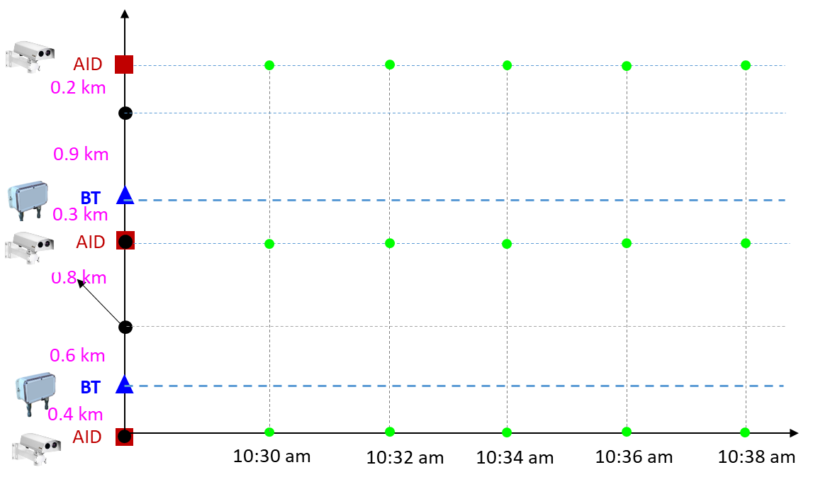
Fusion Ratio
$$R=\frac{\left(1\right) Average BT travel time on the road section between two BT detectors}{\left(2\right) Average of the travel times estimated by AID data over the time period of the journey taken}$$
If fusion ratio R is too large or small
→ R < 0.8 or R > 1.4, do not conduct data fusion due to inconsistency between BT and AID data
(2) Average travel times over the time period taken
(1) Average travel time

Slide 34
Example
With AID data only
With AID data only
AID
BT
AID
BT
AID
1
2
3
4
5
6
0.4 km
0.6 km
0.8 km
0.3 km
0.9 km
0.2 km
Segments with both BT and AID data
IRN segment 1
IRN segment 2
IRN segment 3
1.0 km
0.8 km
1.2 km
3 IRN segments are divided into 6 small segments

Slide 35
IRN Segments with AID Detector Data Only:
With AID data only
With AID data only
AID
BT
AID
BT
AID
(1)
No. of Validated AID Speed Data at 2-min Intervals > 0
Estimate the Average Speed on IRN based on AID Speed Data Only
No. of Validated AID Speed Data at 2-min Intervals = 0
(2)
Use Speed Limit

Slide 36


IRN Segments with Both BT and AID Detector Data:
AID
BT
AID
BT
AID
Segments with both BT and AID data
No. of Validated AID Speed Data at 2-min Interval > 0
Fuse BT Travel Time and AID Speed Data by fusion ratio R* for Average Speed Estimation on IRN at 2-min Interval
(3a)
BT Travel Time Data at 2-min Interval
$$+$$
* 0.8 ≤ R ≤ 1.4
BT Travel Time Data at 2-min Interval (but without change in 3 or more successive time intervals)
No. of Validated AID Speed Data at 2-min Interval > 0
Estimate the Average Speed on IRN based on AID Speed Data Only
(3b)
$$+$$

Slide 37
Malfunction of BT and/or AID Detectors
BT Detector | AID Detector | Estimation of Average Traffic Speeds on IRN Road Segments
✗ | ✓ | Based on AID speed data only
✓ | ✗ | Use the most updated relevant historical data
✗ | ✗ | Use the most updated relevant historical data
Note: ✗ = out of order without real-time data

Slide 38
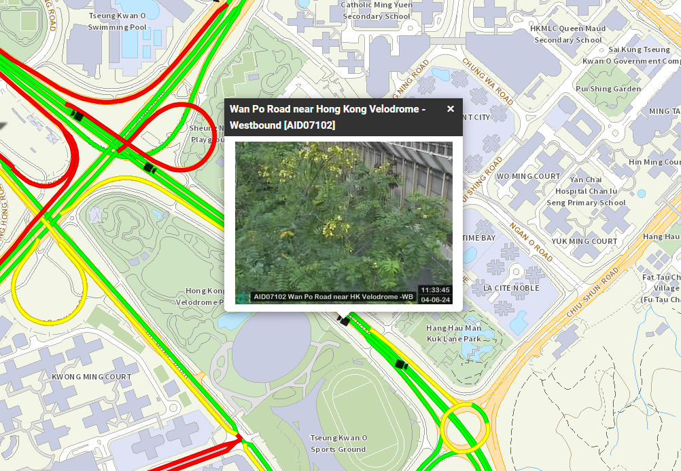
Scenario
AID07102 (In Tseung Kwan O) is blocked by the tree

Slide 39
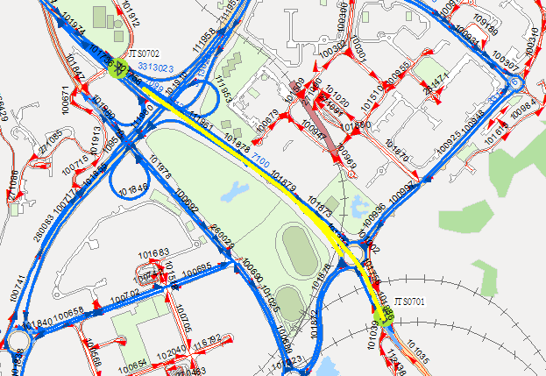
Solution
IRNs 7122-7127, 7290, 7308 originally AID07102~AID07103;
Are replaced by BT pair JTS0701~JTS0702

Slide 40
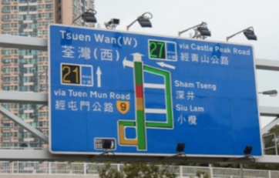
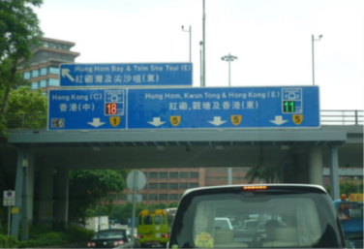
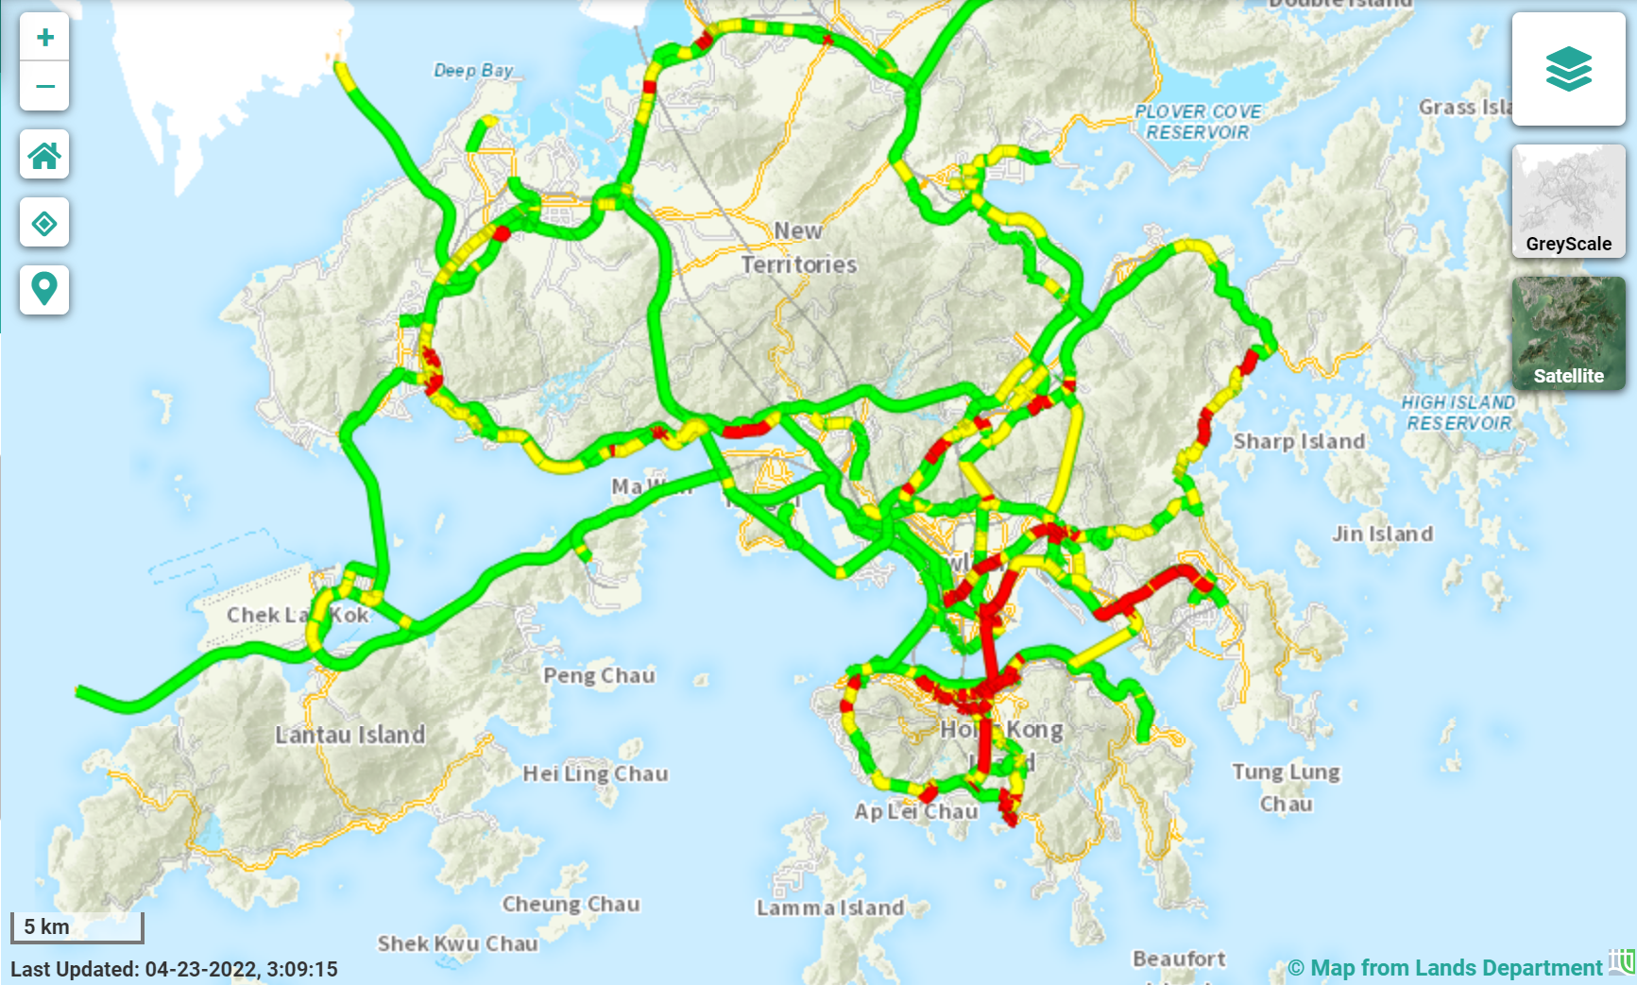
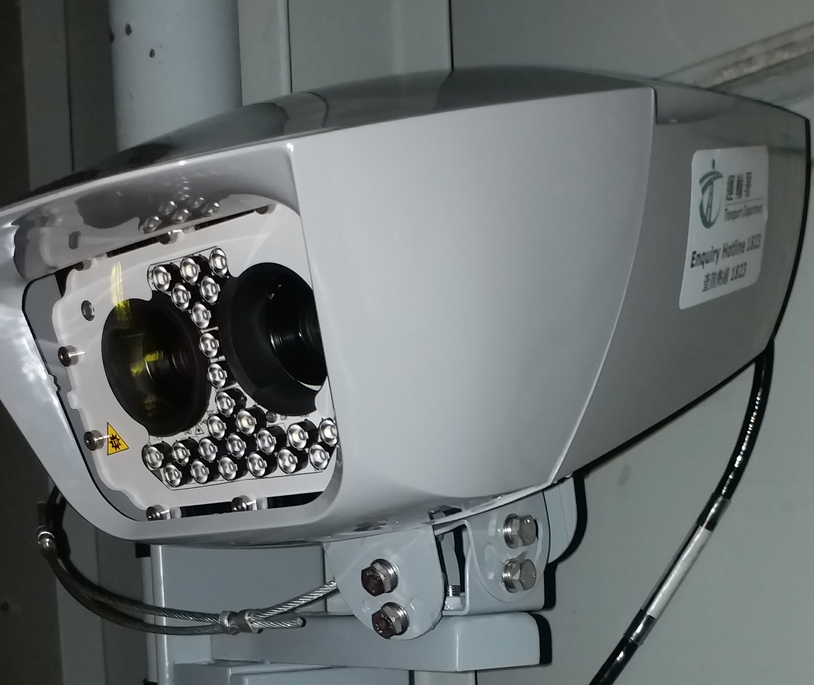
Summary
AID Detectors
Central Computer System (CCS)
AID Software
AID data
Ingress Engine
Data Cleansing
Data Fusion for Estimating Average Traffic Speeds on IRN
Egress Engine
Validated AID & BT data
Average Speeds on IRN Segments
Traffic data and average speeds on IRN
External Services (Data.gov.hk, TIS, TIMS)
Bluetooth (BT) Detectors
BT Software
BT data
ALPR Software
ALPR data
ALPR Detectors
In the project, average speeds are estimated based on AID and BT data, while ALPR data are used for vehicle classification.

Slide 41
End

